Slide 1
DPO – EDPS Workshop:
Data Protection Impact Assessments

Slide 2
Focus:
Sharing practical experience based on past cases
Further input for group discussion

Slide 3

Some highlighted EDPS publications
Accountability on the ground toolkit (mainly part II: DPIAs and prior consultation):
The EDPS’ main guidance document on DPIAs
Step-by-step guide through the DPIA process, including example questions for the controller;
Template report structure;²
Collection of DPIA methodologies employed at national level to draw inspiration from.
Decision from the EDPS which further defines criteria and example lists of processing operations (not) requiring a DPIA or prior consultation
List of criteria that indicate the need to perform a DPIA (used for threshold assessment);
Indicative list of processing operations that may (not) be required to have a DPIA.
EDPS Report: EU Institutions’ use of Data Protection Impact Assessments (Jul 2020)
Statistics regarding the DPIAs conducted by different EUIs up until this point
Public feedback of the EDPS on previous DPIAs
Example: case 2021-0116 & 2020-0568.
Available on edps.europa.eu.

Slide 4

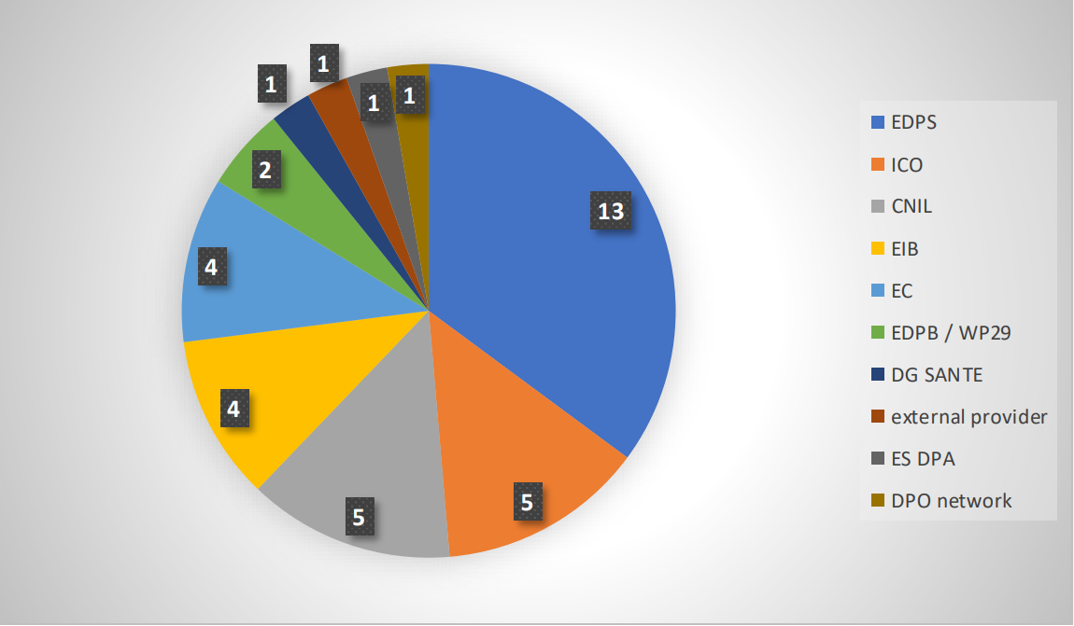
Experiences: structure of DPIA reports
Formatting and length of DPIAs differ greatly between EUIs
Differences in subject matter of the DPIAs (depending on the needs of the EUIs);
Differences in methodology used (see figure);
Difference in building on the EDPS accountability on the ground toolkit
Atleast 13 EUIs have developped specific internal DPIA templates.
No prescribed form – however ‘questionnaire’ formats may lead to incomplete DPIAs.
Methodologies used by EUIs
(Source: EDPS DPIA Survey 2020)

Slide 5
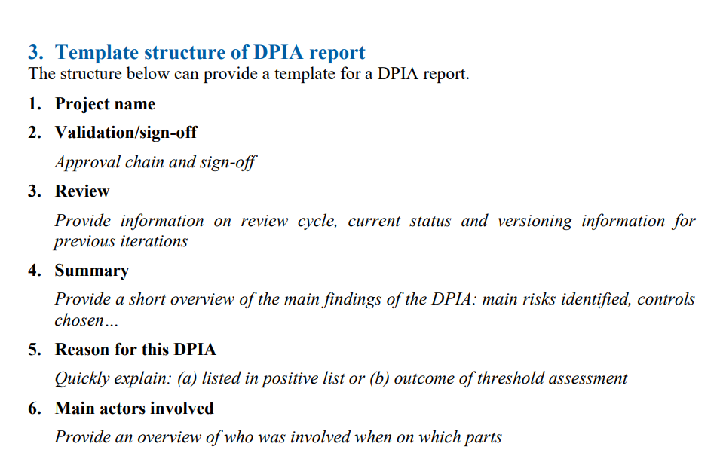

Example structure of a DPIA report

Slide 6
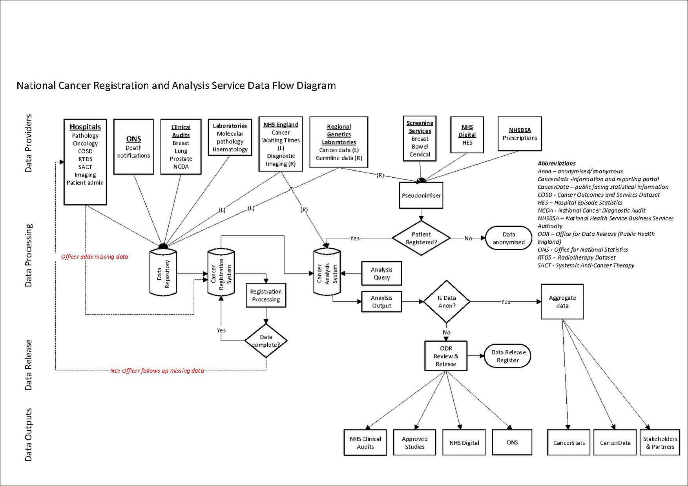
(Step 7) Description of the processing operation
Good practice: taking a diagram of personal data flows as a basis
Allows to capture the lifecycle of the personal data in a single overview, including interactive processes;
Easier to spot if steps are missing in the description;
Controllers may already be preparing workflows for staff or technical documentation which can serve as a basis.
Fig. for illustration only

Slide 7

(Step 8) Necessity and proportionality assessment
Necessity of the EUI activity ‘itself’ versus the necessity to implement that activity in a specific way
Often detailed explanations regarding the necessity of an EUI to perform the planned activity in general.
  Examples:
  - processing of large amounts of photos using a machine learning image recognition model.
Investigating alternatives that are less intrusive
Alternatives are not always available, but should be seriously considered when they are;
Should occur early on in the process to be maximally impactful.

Slide 8

(Step 9) Analysis of the risks to data subjects
Core of the DPIA
Scoring of risks to data subjects remains a difficult exercise
Often, scoring is done using an impact x likelihood formula.
One thing to be careful of is to clearly indicate when a risk has an unknown likelihood of appearing (unknown =/= medium).
For the main risks, clarify where needed how the impact and likelihood were assessed.
Mitigating measures
measures included in the DPIA table can be brief, but should be concrete enough in order to explain how the identified risk will be addressed and which concrete mitigation measure will be applied specifically.

Slide 9
Example from a DPIA:
Risk 25 refers to the fact that the EDPS ‘is unable to gain access to the personal data or processing logs it requested’.
The risk description is the following: ‘The ability of the EDPS to supervise is compromised if the access it is entitled to is not able to be provided’ and the ‘Underlying Data Protection Principle’ is ‘Supervision by EDPS’.
While the focus of the risk identified in the DPIA is on EDPS supervision, the risk to the data subject is not appropriately described. For example, one of the risks to data subjects is the fact that they might not be able to exercise their rights through EDPS as provided for in Article 62 of the Regulation.

